Slide 1
Delivery Delay Prediction
Machine Learning in E-Commerce Logistics

Slide 2
The Project Objective
This project explores the application of Machine Learning techniques to predict delivery delays within an e-commerce logistics environment
Machine Learning
Model Training/ Testing
Late Deliveries
Prediction Accuracy
Multiple Model Performance Comparison
Generate Logistics Insights

Slide 3
Dataset Overview
• Amazon-style E-Commerce Dataset from Kaggle
• 1 Million original rows
• 20,000 sampled records used
• 20+ operational and pricing features
• Binary classification target
To improve computational efficiency and maintain project manageability, a working sample of 20,000 rows was selected for model development.

Slide 4
Dataset Overview
Key Variables Included :
• Product category and subcategory
• Product pricing and discounts
• Seller ratings
• Stock availability
• Shipping time
• Customer ratings and review counts
• Payment methods
• Delivery status
The target variable was transformed into a binary classification problem:
• 0 = On-Time deliveries
• 1 = Delayed deliveries

Slide 5
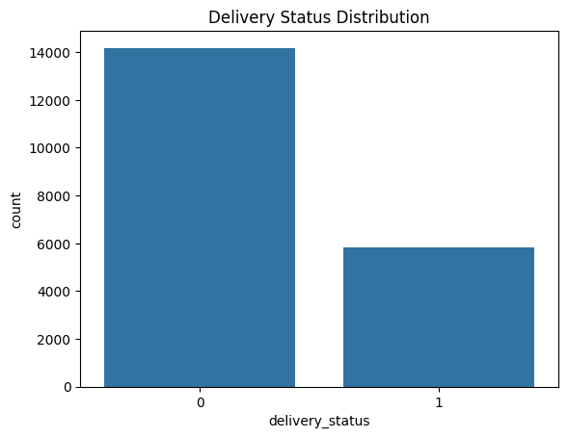
Class Preview
Observation:
About 14000(71%) of product delivery status count as Not delayed
About 6,000 product delivery status count as Delayed
A bias between two (2) classes

Slide 6
Machine Learning Workflow
Data Cleaning
Feature Engineering
Encoding
Train/Test Split
KNN Modeling & Tuning
Random Forest
Evaluation

Slide 7
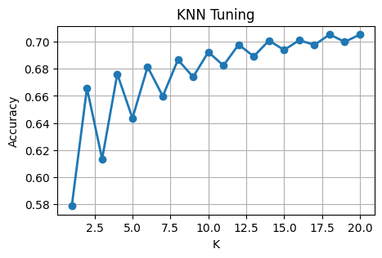
Model Performance & Hyperparameter Tuning
Initial KNN (5) : 64%
Recall:
Non-Delayed = 0.84
Delayed = 0.15
Tuned KNN (18.5) : 70.5%
Recall:
Non Delayed = 0.99
Delayed = 0.02

Slide 8
Random Forest Results
Random Forest Accuracy: 70.8%
Recall Non-delayed: 0.99
Recall Delayed: : 0.01
Observations:
Similar performance to KNN
Strong prediction of Non-delayed deliveries
Persistent class imbalance challenge
Highlighted importance of Evaluation metrics

Slide 9
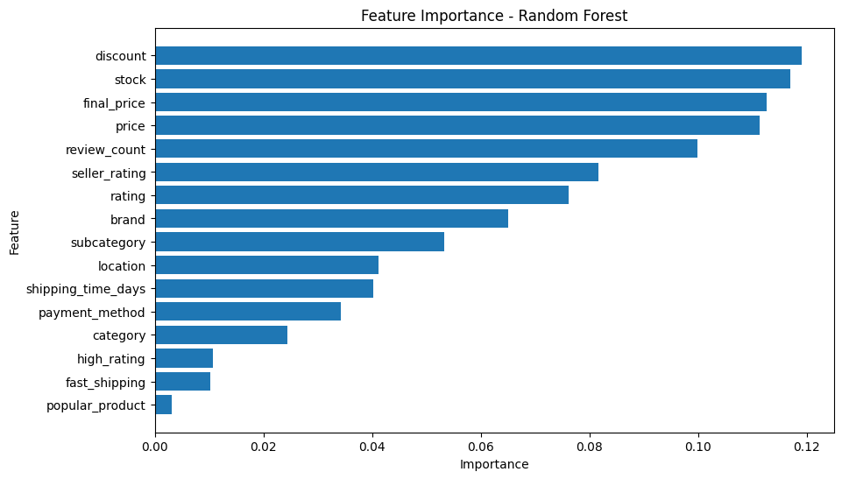
Feature Importance Insights
The Random Forest model identified the following as the most influential features in delivery outcomes:
Discount levels
Stock availability
Product pricing
Product popularity indicators
Suggesting operational and inventory factors may influence delivery performance more strongly than customer behaviour metrics.

Slide 10
Key Insights
• KNN accuracy improved from 64.4% to 70.5% after hyperparameter tuning.
• 71% of records were non-delayed deliveries, creating a class imbalance challenge.
• Random Forest achieved a slightly higher accuracy (70.8%) than KNN (70.5%), but delayed-delivery recall dropped further from 2% to 1%.
• Model performance is also heavily influenced by data feature relevance, not just algorithm selection
Although overall accuracy improved after tuning, evaluation metrics revealed significant class imbalance challenges. The models performed well at identifying non-delayed deliveries but struggled to accurately detect delayed shipments.

Slide 11
Challenges
Future Improvements
Class imbalance between delivery classes
Difficulty predicting delayed deliveries
Limited predictive signals in dataset
Tradeoff between accuracy and recall
Explore additional logistics-related variables such as warehouse information, traffic conditions, weather data and carrier performance
Experiment with techniques for handling class imbalance(SMOTE Oversampling/ undeersampling)
Test more advanced machine learning models

Slide 12
Conclusion
While the models achieved moderate predictive performance, the project mostly highlights :
Machine learning effectiveness depends as much on data quality and evaluation as on algorithm selection
Accuracy alone is insufficient; meaningful evaluation requires deeper performance metrics and interpretation
Operational variables such as inventory and pricing can provide valuable predictive signals for logistics outcomes

Slide 13

THANK YOU!
Selasey Junior

